Slide 1

UNIVERSITY INSTITUTE OF ENGINEERING
COMPUTER SCIENCE ENGINEERING
Bachelor of Engineering (Computer Science & Engineering)
Subject Name: Block chain Technology
Subject Code: 20_CST-412
Types of block chain
Mapped with CO2
Prepared By:
Er. Ankita Sharma
DISCOVER . LEARN . EMPOWER

Slide 2
Types of block chains
Block chain applications can be used for a variety of operations such as finance, supply chain monitoring, and identity validation. Depending on the application and the need of participating entities (security, performance, etc).

Slide 3
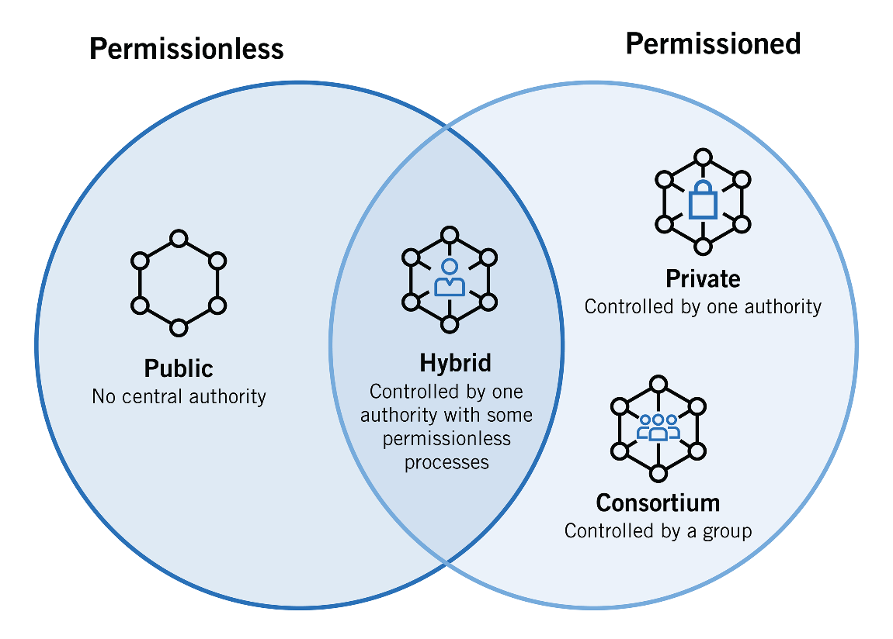
There are two types of block chains available, permissioned and permission less. We’ll take a brief tour of both below and then explore permissioned block chains in greater detail below.

Slide 4


Slide 5
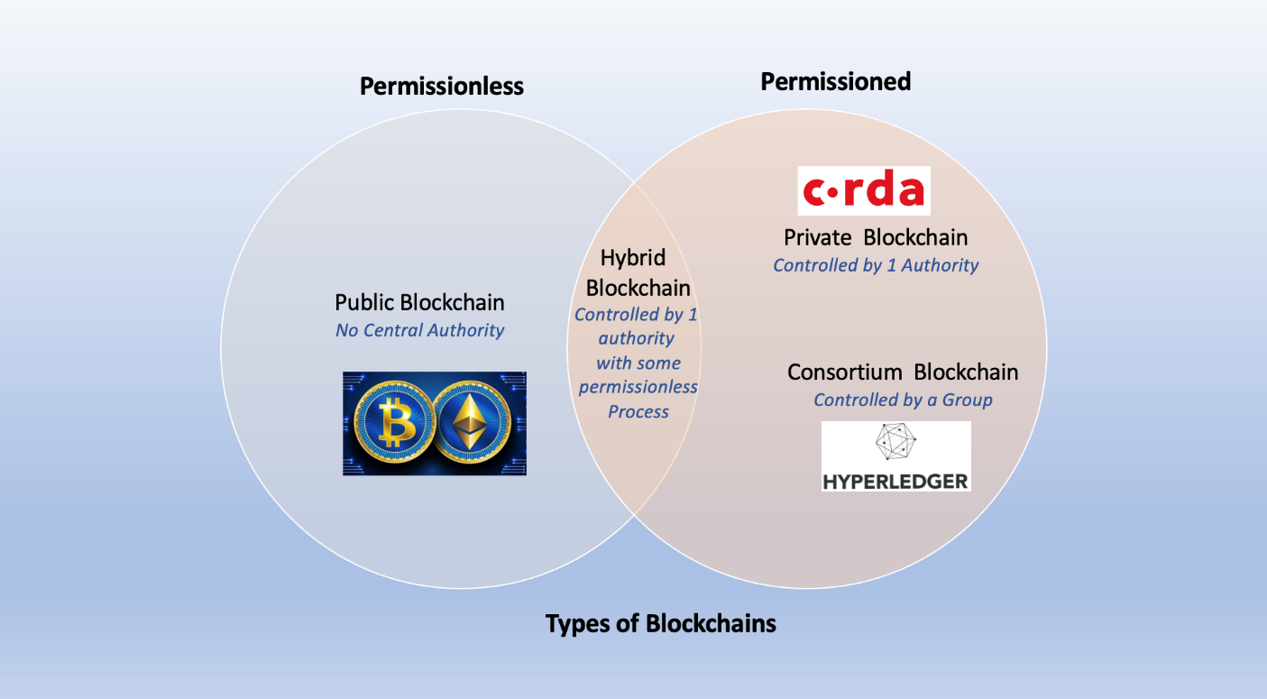
Permissioned block chains - Closed networks with limited decentralization, an additional access control layer, and designated entities

Slide 6
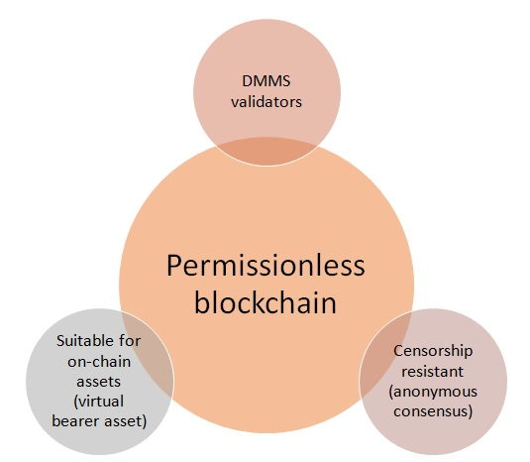
Permission less block chains - Open, decentralized networks with universal consensus validation; anyone can join the network and possess a copy of the ledger

